Slide 1

Arduino Mega 2560

Slide 2
Prepared by
Amgad Magdy Fathy Sayed Ahmed
Academic No. 1900113
Section No. 1

Slide 3
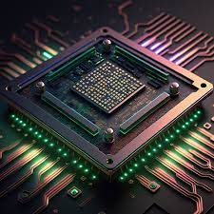
Agenda
Overview
Technical Specification
Reference(Datasheet)

Slide 4
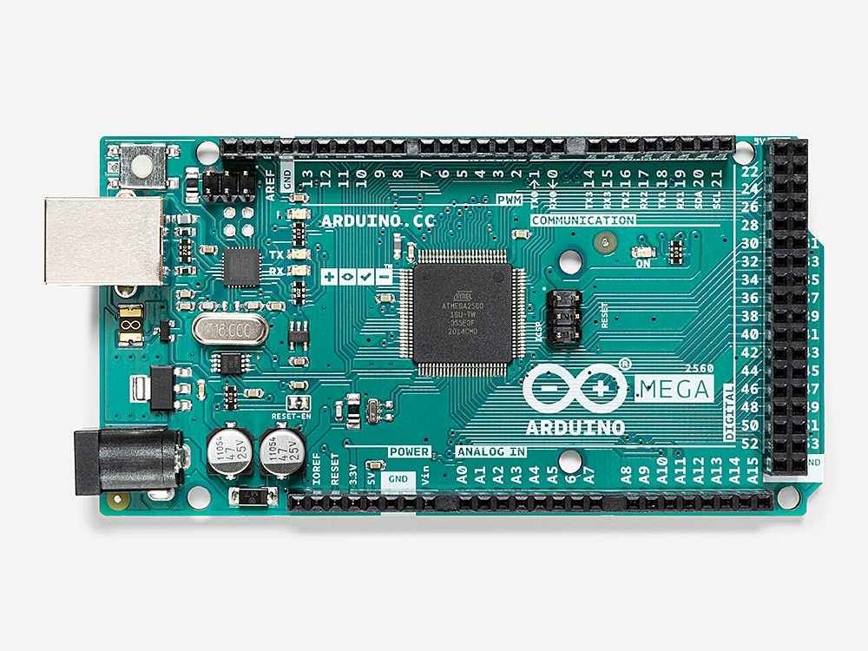
Overview

Slide 5
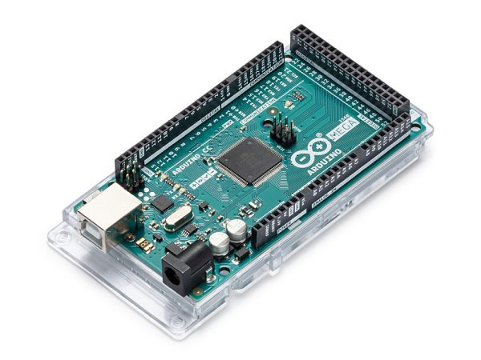
What’s Arduino Mega 2560
Arduino Mega 2560 is an exemplary development board dedicated for building extensive applications as compared to other maker boards by Arduino. The board accommodates the ATmega2560 microcontroller, which operates at a frequency of 16 MHz . The board contains 54 digital input/output pins, (of which 15 can be used as PWM outputs), 16 analog inputs, 4 UARTs (hardware serial ports), a USB connection, a power jack, an ICSP header, and a reset button.

Slide 6
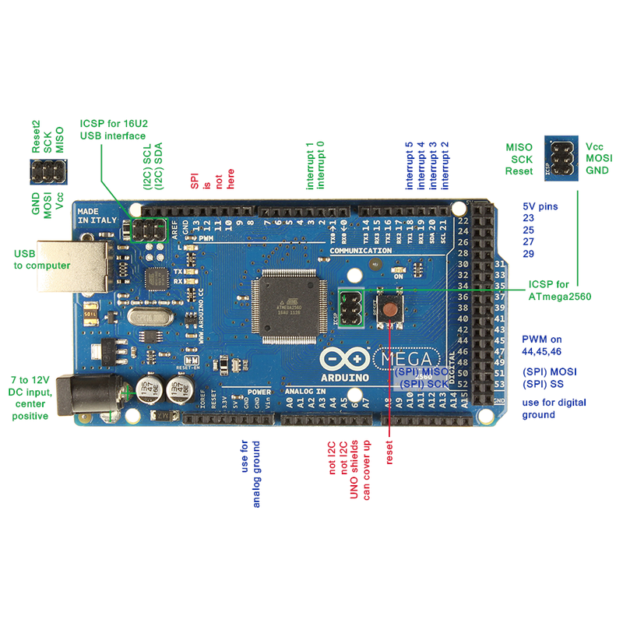
Technical Specification
Crystal
oscillator

Slide 7
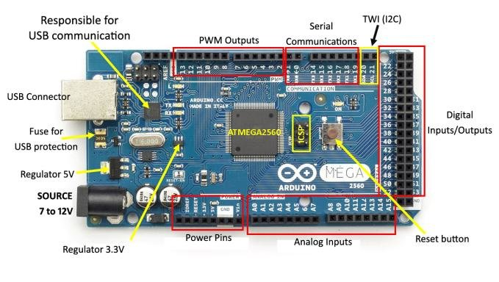
Microcontroller | ATmega2560
Operating Voltage | 5V
Input Voltage (recommended) | 7-12V
Input Voltage (limit) | 6-20V
Digital I/O Pins | 54 (of which 15 provide PWM output)
Analog Input Pins | 16
DC Current per I/O Pin | 20 mA
DC Current for 3.3V Pin | 50 mA
Flash Memory | 256 KB of which 8 KB used by bootloader
SRAM | 8 KB
EEPROM | 4 KB
Clock Speed | 16 MHz
LED_BUILTIN | 13
Length | 101.52 mm
Width | 53.3 mm
Weight | 37 g

Slide 8
Board
ATmega2560 Processor
Up to 16 MIPS Throughput at 16MHz
256k bytes (of which 8k is used for the bootloader)
4k bytes EEPROM
8k bytes Internal SRAM
32 × 8 General Purpose Working Registers
Real Time Counter with Separate Oscillator
Four 8-bit PWM Channels
Four Programmable Serial USART
Controller/Peripheral SPI Serial Interface

Slide 9
Board
ATmega16U2
Up to 16 MIPS Throughput at 16 MHz
16k bytes ISP Flash Memory
512 bytes EEPROM
512 bytes SRAM
USART with SPI master only mode and hardware flow control (RTS/CTS)
Master/Slave SPI Serial Interface

Slide 10
Board
Power
USB Connection
External AC/DC Adapter

Slide 11
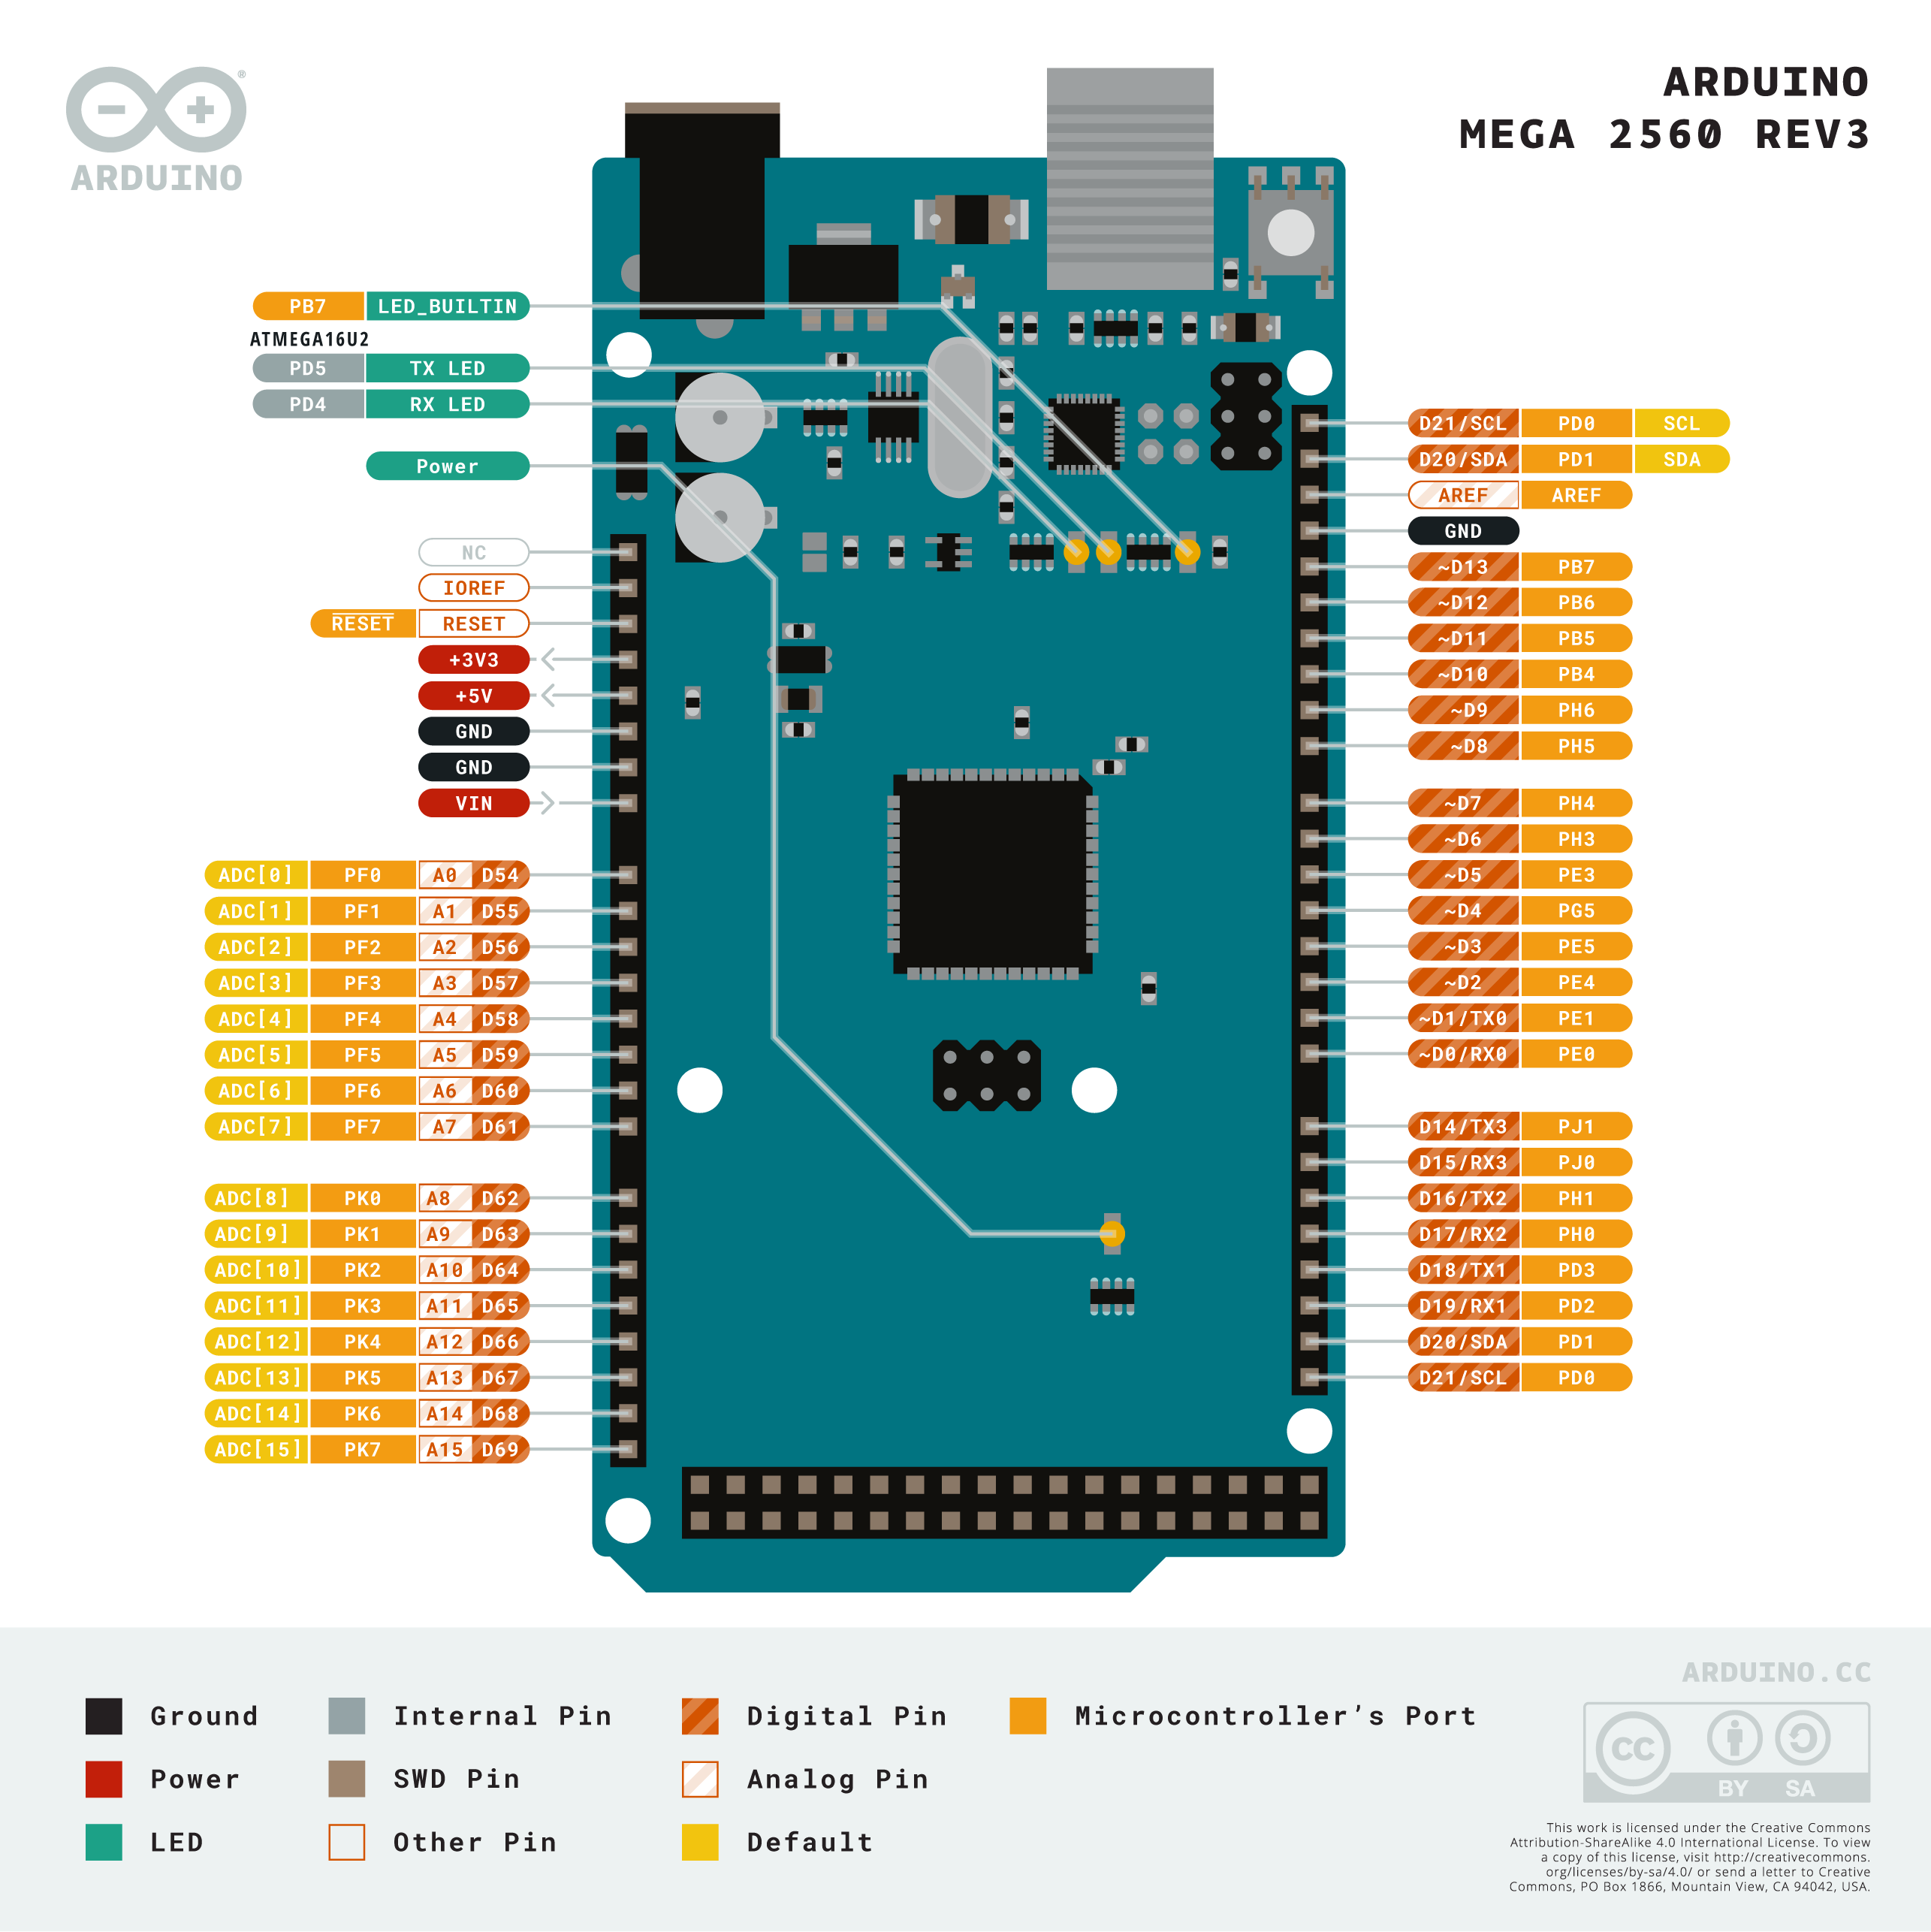
Board
I/O Pinouts
54 digital I/O pins.
16 analog input pins.
15 PWM Output

Slide 12
Reference
https://docs.arduino.cc/hardware/mega-2560/

Slide 13
THANK YOU

